Slide 1
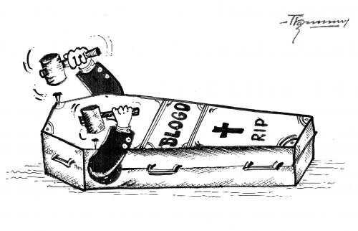
Cancer
Lesson 2.5
How is cell death controlled in normal cells and disrupted in cancer?

Slide 2
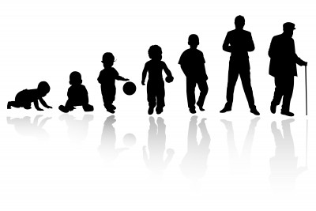
Do now
What happens to a cell that gets old or damaged?

Slide 3
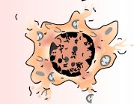
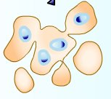
How do cells die?
Necrosis
Apoptosis
Cell explodes
Cell shrinks

Slide 4
What is Necrosis?
Necrosis
Results from tissue injury or infection
Cell swells and bursts
Causes inflammation and tissue damage
Cell explodes

Slide 5
What is Apoptosis?
Results from external or internal signals (like nutrient starvation or DNA damage).
Cell shrinks.
No inflammation or tissue damage because phagocytes clear the cell debris.
Apoptosis
Cell shrinks

Slide 6
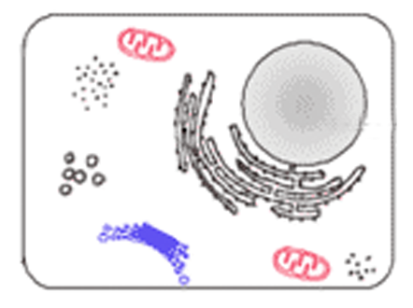
What signals cause apoptosis?
External ‘Die’ signals
Internal ‘Die’ signals
External signals:
Lack of Oxygen
Stress
Tissue Damage
Internal signals:
DNA damage

Slide 7
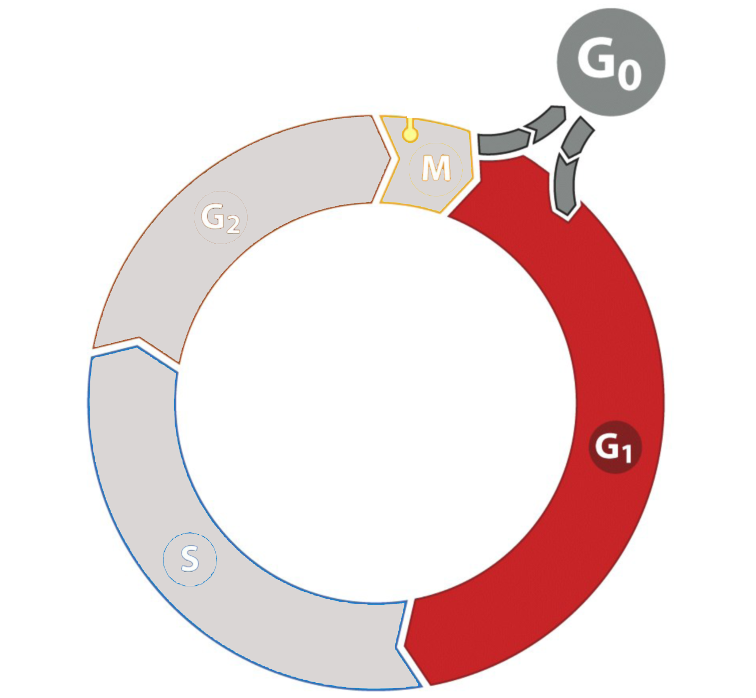
p53 - the ‘master regulator’ of apoptosis
External signals:
Lack of Oxygen
Stress
Tissue Damage
Internal signals:
DNA damage
p53
G₁ Checkpoint/ Restriction Point
Cell cycle arrest

Slide 8
What happens inside the cell after cell cycle arrest?
Cell Cycle Arrest
Can DNA
be repaired?
p53
Yes
No
Survive
Apoptosis

Slide 9
What happens during apoptosis?
Apoptosis proteins open pore in
mitochondria
‘Die’ signals from p53
Mitochondria
release ‘death’ proteins
Apoptosis!
Once pore is open,
it cannot be closed!
Mitochondria

Slide 10
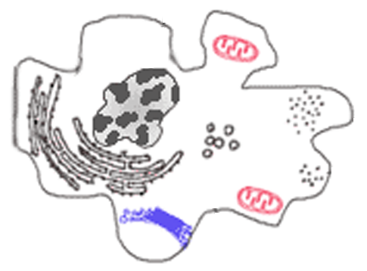
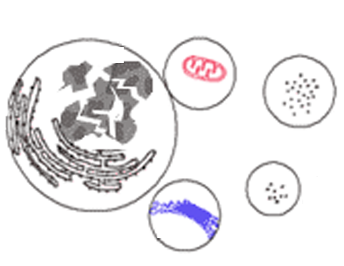
What does apoptosis look like?
nucleus
nucleus
nucleus
blebs
blebs
The cell blebs
Nucleus condenses
Nucleus fragments
The blebs float away and are phagocytosed

Slide 11
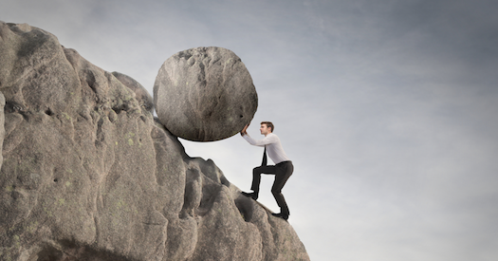
Apoptosis is the default state for cells
Survival
Cell Signals
Apoptosis

Slide 12
Different signals that determine cell fate
Survive!!
Differentiate!!
Divide!!
Don’t divide !!
Don’t Differentiate!!
Die!!

Slide 13
Survival signals prevent apoptosis from happening
Survive!!

Slide 14
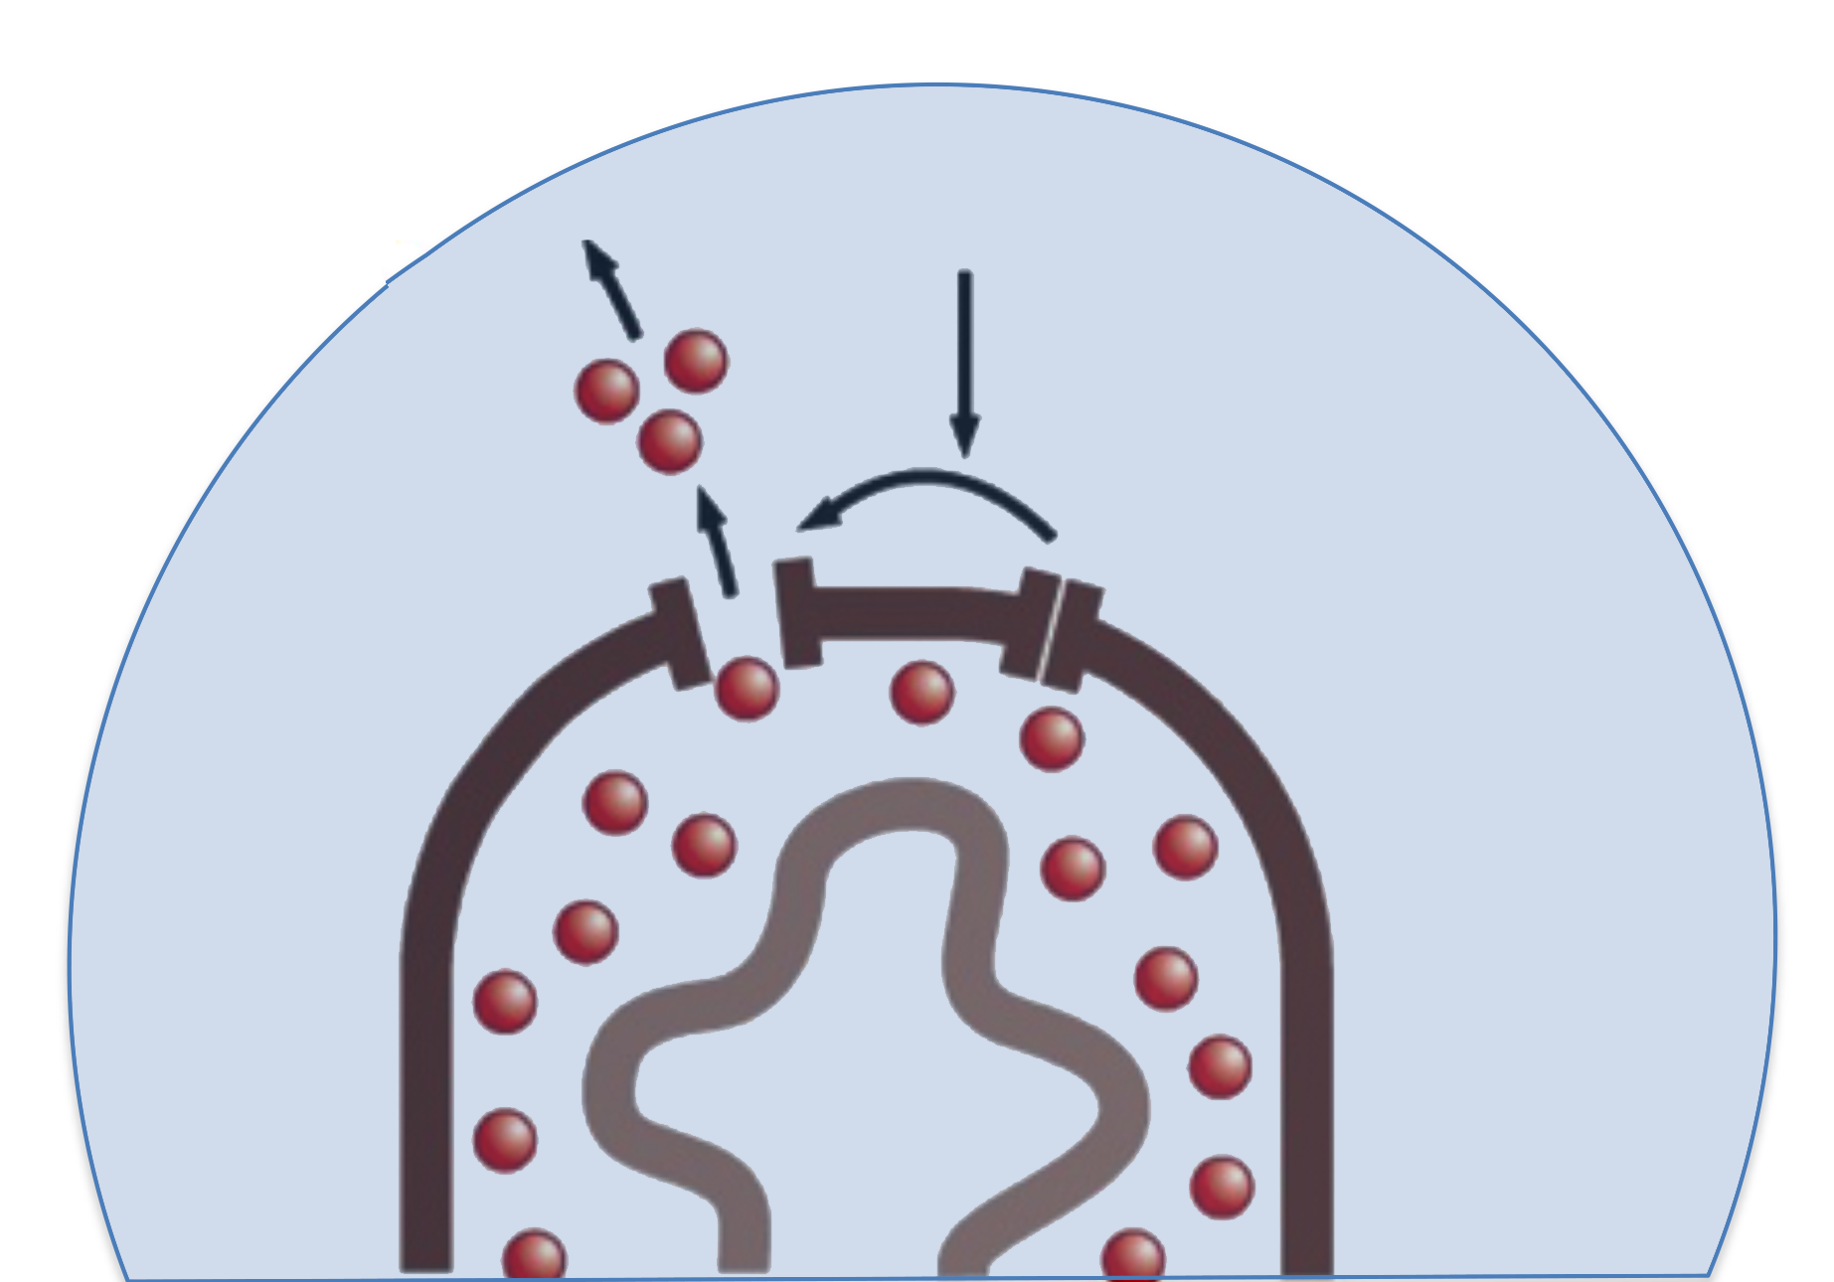
Survival signals make proteins that block mitochondrial pores
Survival signals
Mitochondria can’t release death proteins

Survival!
Survival signals make survival protein
Survival protein blocks pore

Slide 15
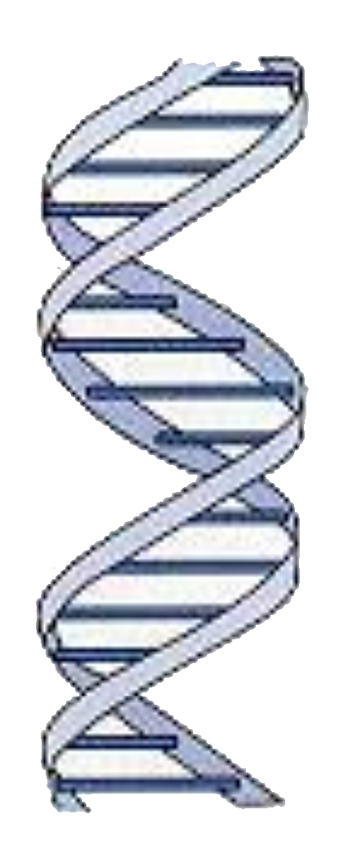
All cell fate signals use similar mechanisms
Survive!!
Transcription factors
Differentiate!!
Divide!!
Y
Y
p53
Y
T F
Receptors
Y
Y
Don’t divide !!
Y
Don’t Differentiate!!
Transduction
proteins
Die!!

Slide 16
Activity:
Apoptosis Card Game
Students work in pairs and compete against each other to determine whether the cell will survive or die.

Slide 17
Wrap Up: cell survival is a dynamic balance
Survive!!
Divide!!
Differentiate!!
Die!!
Don’t Divide!!
Don’t Differentiate!!
Survival/Death signals oppose each other
Signals that promote Division/differentiation lead to survival
Signals that inhibit division/differentiation lead to death

Slide 18
What happens when DNA is damaged in normal cells?
DNA
Damage
Cell Cycle Arrest
p53
Can DNA be repaired?
Yes
No
Survive
Apoptosis
Notes:
External carcinogens
Internal stresses – nitrates and metabolic reactions stemming from obesity

Slide 19
What happens when DNA is damaged in cancer cells?

DNA
Damage
Cell Cycle Arrest
p53


Repair DNA?
Yes
No

Survive
Apoptosis
Notes:
External carcinogens
Internal stresses – nitrates and metabolic reactions stemming from obesity

Slide 20
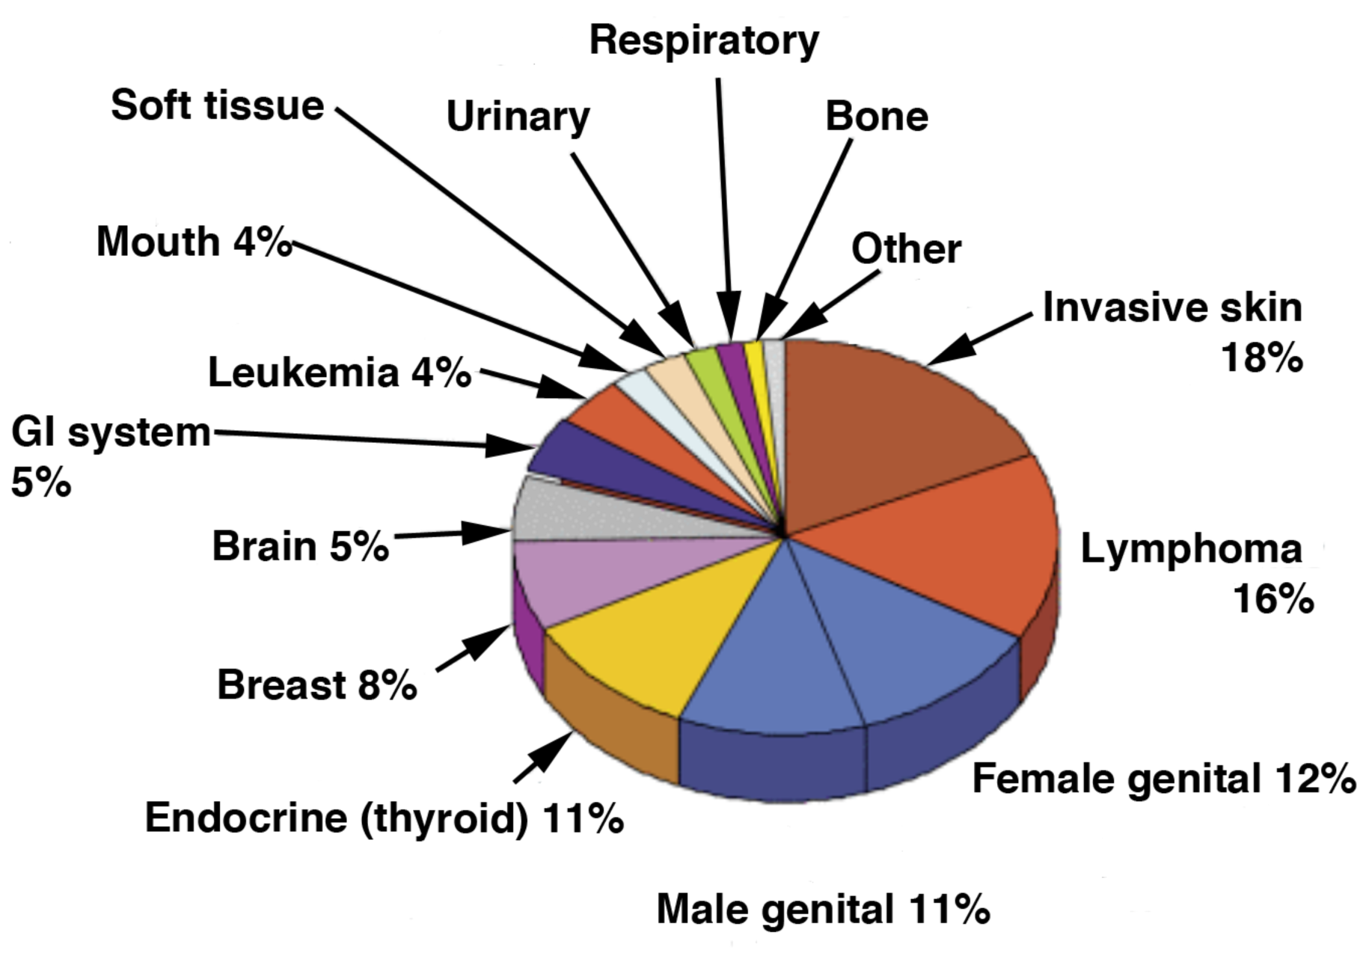
Mutations in p53 are common in Cancers
Cancers affecting 25-29 year olds
60%
80%
xx
80%
10%
xx
60%
xx
30%
xx
60%
xx
xx
xx
Percent of cancers with p53 mutations
xx

Slide 21
Homework
Read article about how inhibitors of apoptosis genes could promote healing.

